Slide 1


Softmax Equation Statistics
Artificial Intelligence Training Created by Andrew Ferlitsch Instructor
July, 2017

Slide 2
Max Equation
The max() equation returns the largest value from a set of values.
max( x₁, x₂, x₃, x₄, x₅ )
^{x ∈ S}
S : Set of Discrete Values
R: Set of Continuous Real Values
∈ : Symbol for Element of a Set
x_{i} : An Instance of an Element of a Set
≥ : Greater than or equal to for all elements in a set
Condition is met where element x_{j} is the maximum in x ∈ S, when:
x_{j} ≥ x_{i} , x ∈ S
Enumerated set of values (S)
For all x that are elements of set x
x_{j} is greater than or equal to all elements x_{i} in set S

Slide 3
SoftMax Equation
The softmax() equation takes as input a set of real values,
and outputs a new set of values between 0 and 1, and where
the values add up to one.
Typically used in squashing the outputs of a neural network.
Inputs can be any real values of any range (e.g., > 1.0).
Outputs from softmax represent probabilities.
A value between
0 and 1.
z₁
Softmax
f(z₁) ∈ R{ 0, 1 }
z₂
f(z₂) ∈ R{ 0, 1 }
Inputs: z₁, z₂, .. z_{k ,}
z ∈ R
Outputs: all values sum
(add) upto 1.0.
z₃
f(z₃) ∈ R{ 0, 1 }
Can be any
real value.
z_{k}
f(z_{k}) ∈ R{ 0, 1 }
Known as Boltzmann function in Physics

Slide 4
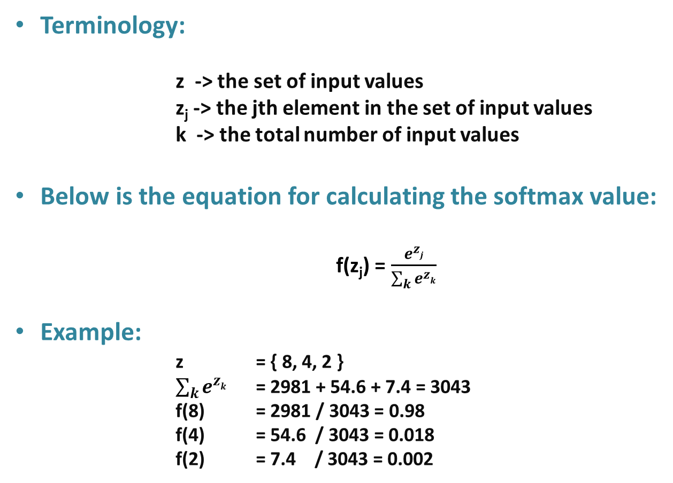
SoftMax Equation
Terminology:
z -> the set of input values
z_{j} -> the jth element in the set of input values
k -> the total number of input values
Below is the equation for calculating the softmax value:
f(z_{j}) = $\frac{e^{zj}}{\sum_{k}{e^{zk}}}$
Example:
z = { 8, 4, 2 }
$\sum_{k}{e^{zk}}$ = 2981 + 54.6 + 7.4 = 3043
f(8) = 2981 / 3043 = 0.98
f(4) = 54.6 / 3043 = 0.018
f(2) = 7.4 / 3043 = 0.002
All values add up to 1

Slide 5
Example Application – Neural Networks
Neural Network - Classification
Hidden Layer
Classification
probabilities, e.g.,
90% apple
6% pear
3% orange
1% banana
Input Layer
Output Layer
z₁
Softmax
f(z₁) ∈ R{ 0, 1 }
x₁
z₂
f(z₂) ∈ R{ 0, 1 }
x₂
z₃
f(z₃) ∈ R{ 0, 1 }
x₃
z_{k}
f(z_{k}) ∈ R{ 0, 1 }
Features
Predicted
output
(real) values

Slide 6
Torch Library
torch is a python library for machine learning
Neural Networks Support Functions Name Alias
import torch.nn.functional as F
probabilities = F.softmax( list )
Results returned as a list list of values outputted
probabilities adding up to 1 by neural network
Example:
0.98, 0.012, 0.002 = F.softmax( [ 8, 4, 2 ] )

